Slide 1
Unit – III
Small Signal Analysis of BJT

Slide 2
Hybrid h-Parameter model for a transistor
The equivalent circuit of a transistor can be drawn using simple approximation by retaining its essential features.
These equivalent circuits will aid in analyzing transistor circuits easily and rapidly.
A transistor can be treated as a two part network. The terminal behavior of any two part network can be specified by the terminal voltages V₁ & V₂ at parts 1 & 2 respectively and current i₁ and i₂, entering parts 1 & 2, respectively, as shown in figure.

Slide 3
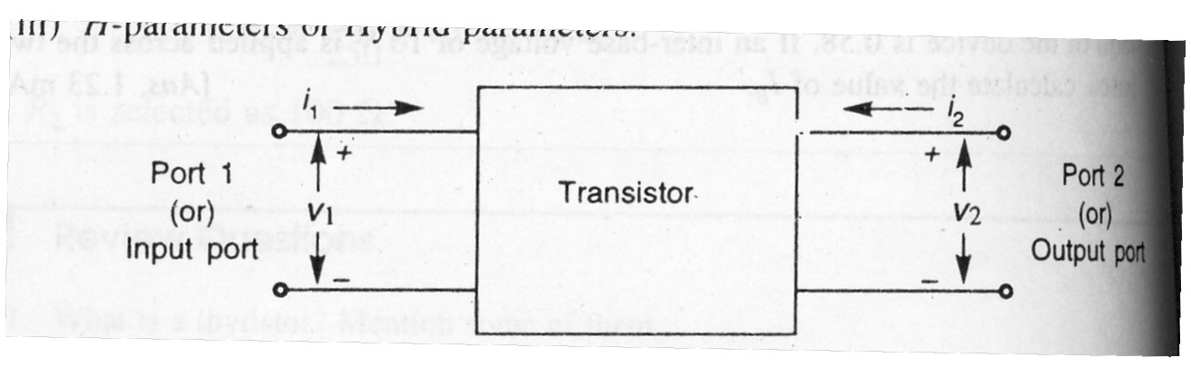
Two Port Network
Of these four variables V­₁, V₂, i₁ and i₂, two can be selected as independent variables and the remaining two can be expressed in terms of these independent variables
.
This leads to various two port parameters out of which the following are more important.

Slide 4
If the input current i₁ and output Voltage V₂ are takes as independent variables, the input voltage V₁ and output current i₂ can be written as
V₁ = h₁₁ i₁ + h₁₂ V₂
i₂ = h₂₁ i₁ + h₂₂ V₂
The four hybrid parameters h₁₁, h₁₂, h₂₁ and h₂₂ are defined as follows.
h₁₁ = [V₁ / i₁] with V₂ = 0
= Input Impedance with output short circuited

Slide 5
h₂₂ = [i₂ / V₂] with i₁ = 0
= Output admittance with input open circuited.
h₁₂ = [V₁ / V₂] with i₁ = 0
= reverse voltage transfer ratio with input open circuited.
h₂₁ = [i₂ / i₁] with V₂ = 0
= Forward current gain with output short circuited.

Slide 6
The dimensions of h – parameters are as follows:
h₁₁ - Ω
h₂₂ – mhos
h12, h21 – dimension less.
as the dimensions are not alike, (i.e) they are hybrid in nature, and these parameters are called as hybrid parameters.

Slide 7
The Hybrid Model for Two-port Network:-
V₁ = h₁₁ i₁ + h₁₂ V₂
I₂ = h₂₁ i₁ + h₂₂ V₂
↓
V₁ = h_{i} i₁ + h_{r} V₂
I₂ = h_{f} i₁ + h₀ V₂

Slide 8
hi ,hf, hr, ho
Notations used in transistor circuits:-
h₁₁ = h_{i} = Short circuit input impedance
h₂₁ = h_{f} = Short circuit forward current Gain.
h₁₂ = h_{r} = Open circuit reverse voltage transfer ratio
h₂₂ = h_{o} = Open circuit output admittance

Slide 9
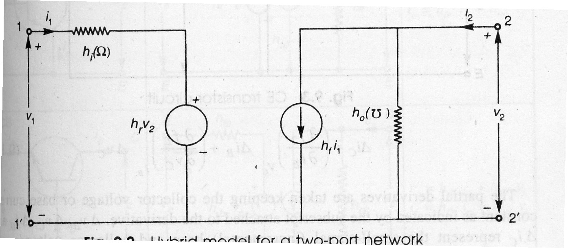
The Hybrid Model for Transistor

Slide 10
Transistor Hybrid Model
Use of h – parameters to describe a transistor have the following advantages:
h – parameters are real numbers up to radio frequencies .
They are easy to measure
They can be determined from the transistor static characteristics curves.
They are convenient to use in circuit analysis and design.
Easily convert able from one configuration to other.
Readily supplied by manufactories.

Slide 11
Transistor Hybrid Model CE Configuration
In common emitter transistor configuration, the input signal is applied between the base and emitter terminals of the transistor and output appears between the collector and emitter terminals. The input voltage (V_{be}) and the output current (i_{c}) are given by the following equations:
V_{be} = h_{ie}.i_{b} + h_{re}.V_{c}
i_{e} = h_{fe}.i_{b} + h_{oe}.V_{c}

Slide 12
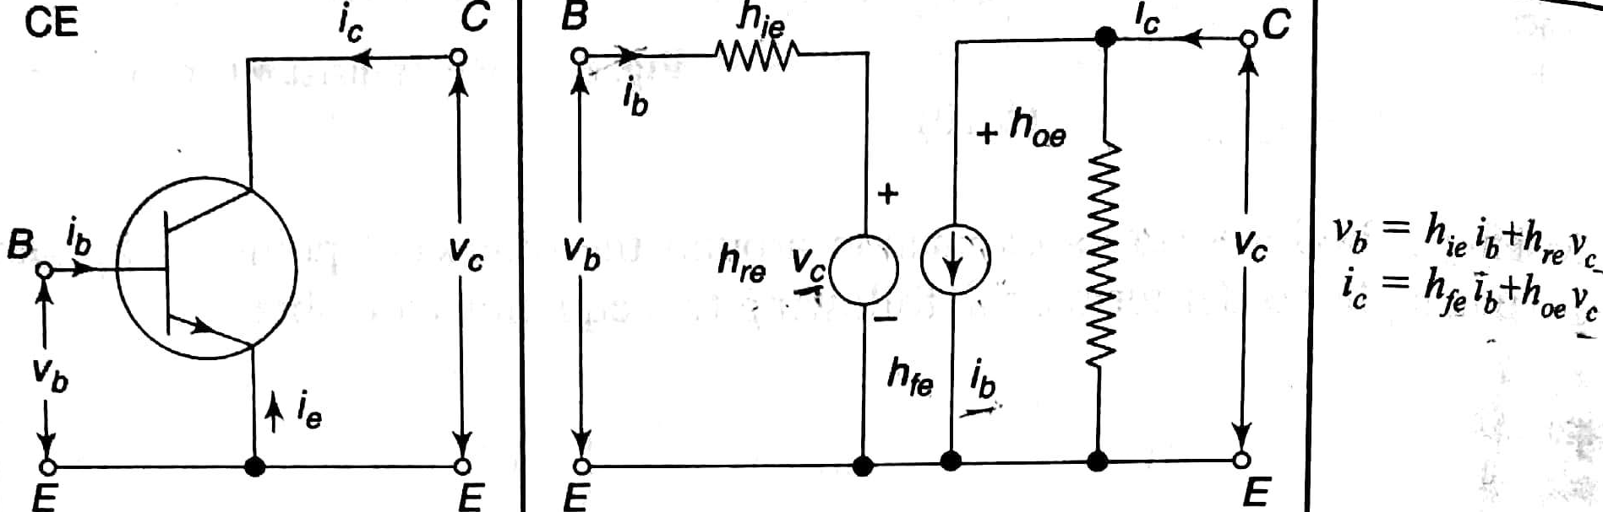
Hybrid model for CE configuration

Slide 13
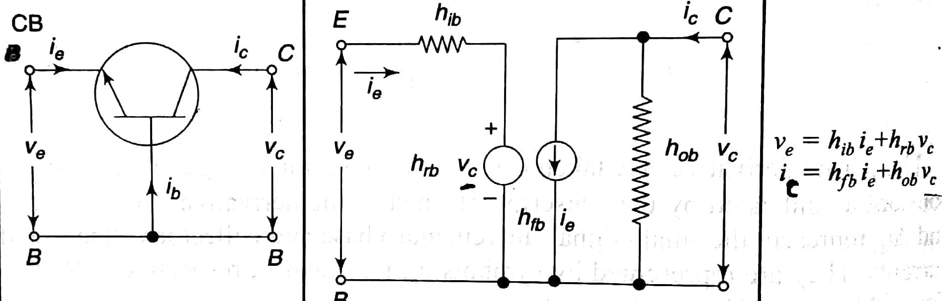
Hybrid model for CB configuration

Slide 14
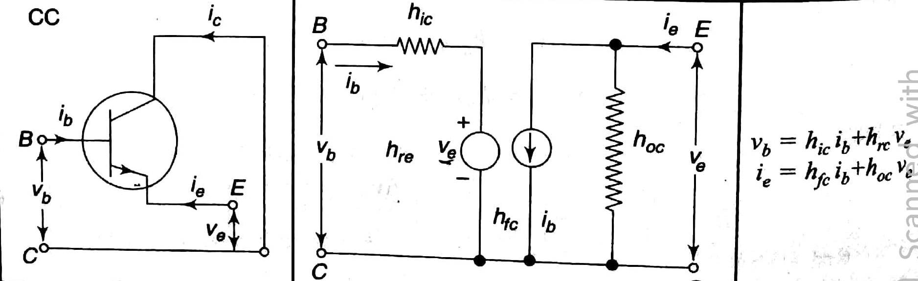
Hybrid model for CC configuration

Slide 15
h-parameters
parameter | CE | CB | CC
INPUT RESISTANCE | hie | Hib | Hic
REVERSE VOLTAGEGAIN | hre | hrb | hrc
FORWARD TRANSFER CURRENTGAIN | hfe | hfb | hfc
OUTPUT ADMITTTANCE | hoe | hob | hoc

Slide 16
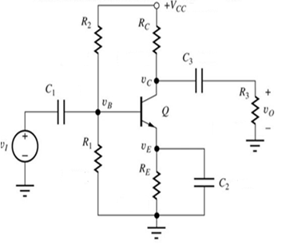
CE Amplifier
Common Emitter amplifier:
In a practical amplifier design, C₁ is large coupling capacitor or dc blocking capacitor.
C₂ is a bypass capacitor. It provides a low impedance path for ac current from emitter to ground. It effectively removes R_{E} (required for good Q-point stability) from the circuit when ac signals are considered.
AC coupling through capacitors is used to inject an ac input signal and extract the ac output signal without disturbing the DC Q-point.
Capacitors provide negligible impedance at frequencies of interest and provide open circuits at dc
Instantaneous output voltage
V_{c} = V_{cc}-I_{c}R_{c}

Slide 17
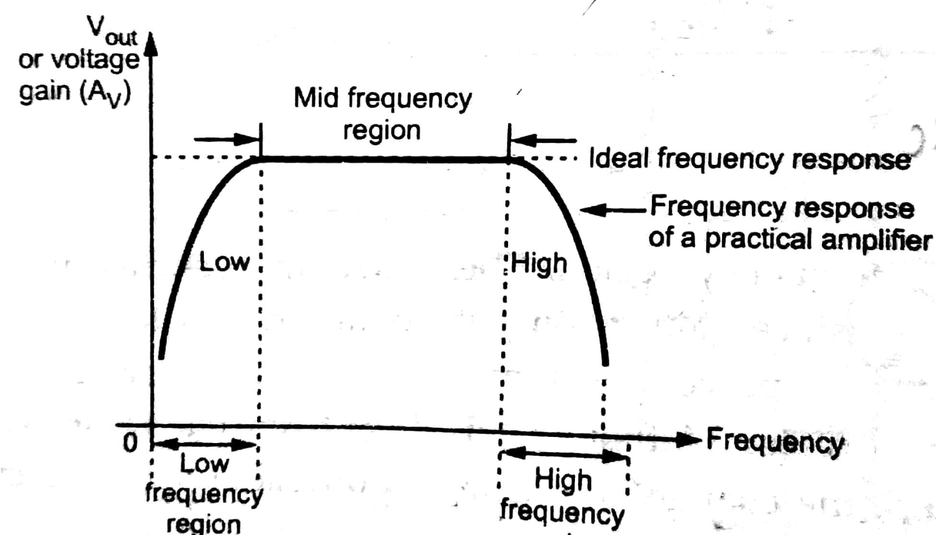
Frequency response of CE amplifier

Slide 18
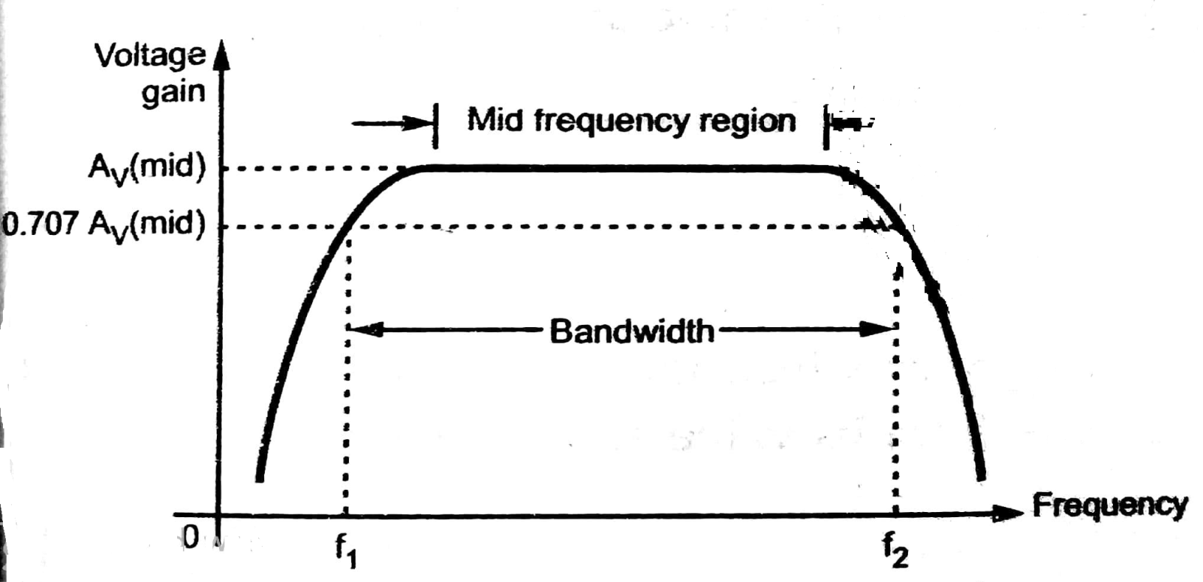
Band width

Slide 19
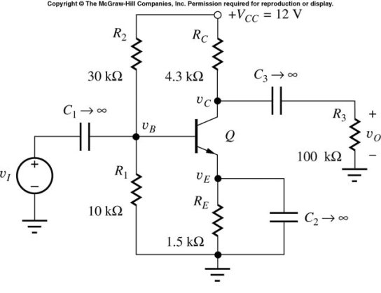
A Practical BJT Amplifier using Coupling and Bypass Capacitors
In a practical amplifier design, C₁ and C₃ are large coupling capacitors or dc blocking capacitors, their reactance (X_{C} = |Z_{C}| = 1/ωC) at signal frequency is negligible. They are effective open circuits for the circuit when DC bias is considered.
C₂ is a bypass capacitor. It provides a low impedance path for ac current from emitter to ground. It effectively removes R_{E} (required for good Q-point stability) from the circuit when ac signals are considered.

Slide 20
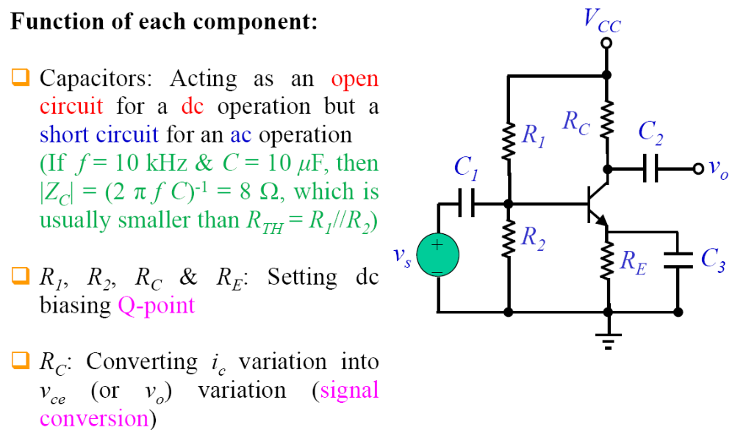
Analysis of BJT amplifiers

Slide 21
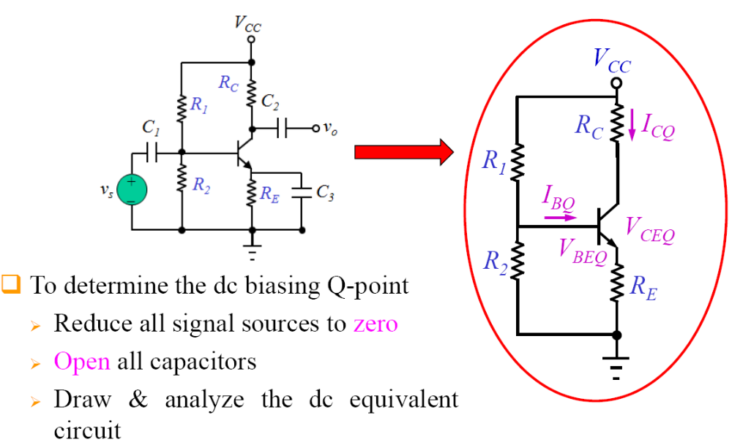
dc analysis and equivalent circuit

Slide 22
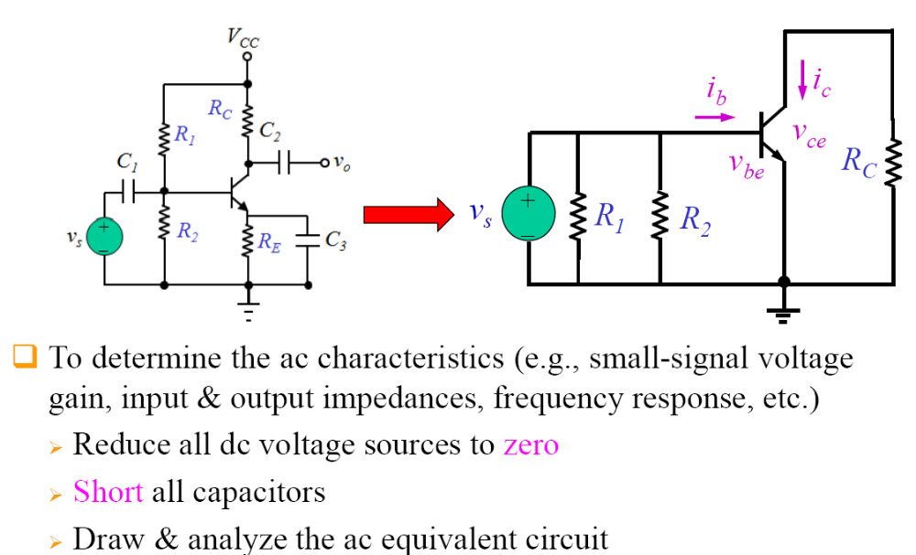
ac analysis and equivalent circuit

Slide 23
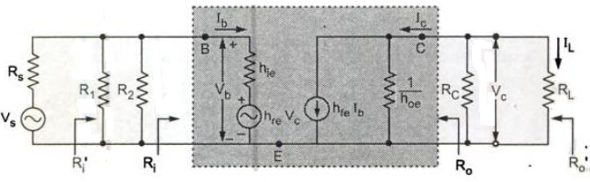
H-parameter equivalent of CE amplifier

